Slide 1
Stress Effects on Statistical Learning
Feb 2021

Slide 2
Statistical Learning
Statistical Learning = the ability of the brain to extract statistical regularities to learn generalizable rules about the environment
Traditional memory models suggest that this is supported mainly by the cortex
Recent studies demonstrated that the hippocampus can play a role in rapid statistical learning
Temporal communities are predictable relationships about which stimuli are likely to co-occur
Temporal communities can be used implicitly in event segmentation
Shapes with statistical relationships had more similar patterns of activation in fMRI
The hippocampus was necessary for the formation of community representations

Slide 3
Stress and the Hippocampus
Stress impacts a variety of medial temporal functions
Supportive of generalization during encoding
Often obstructive during retrieval
Can induce need for further evidence accumulation
Predictions
Increased performance for encoding group
Decreased performance for retrieval group
Increased lag in response time for the retrieval group
Notes:
Screen capture of the task

Slide 4
Study Goals
Quantify whether and how acute stress impacts statistical learning
Quantify the relationship between performance on temporal community learning tasks and individual differences
Evaluate the relationship between conscious awareness of statistical relationships and demonstrated implicit learning

Slide 5
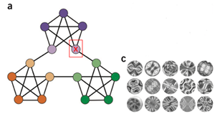
Methodology
Statistical Learning Task
Learning Phase: Subjects see a series of 1400 abstract stimuli, following statistical rules
Retrieval Phase: Subjects see another series of 600 shapes, following the same rules. They are asked to press the spacebar when they feel there is a “natural breaking point” in the sequence
Stress Induction Procedure
Salivary Cortisol Measures

Slide 6
Node Selection Measure
Parse on Step 2 would be considered a node response
1
2

Slide 7
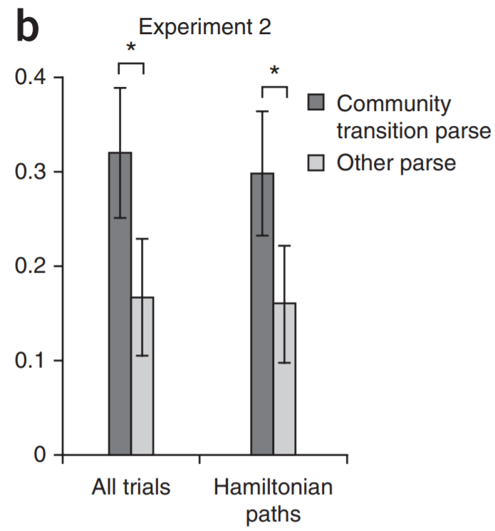
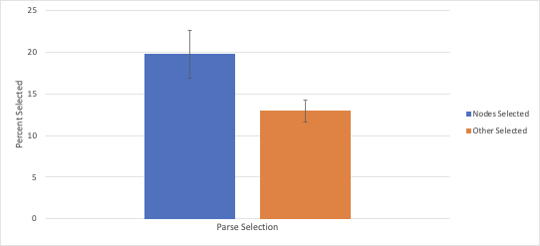
p= 0.036 between node and all other parse selections (for the control group participants specifically)
Trend of implicit learning in control group, though smaller effect than original study
Notes:
Corrected for those with lack of responses in general

Slide 8
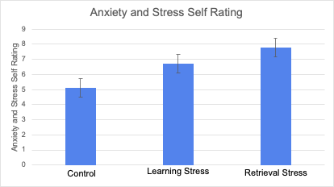
Were the stress groups truly stressed?
Single Factor ANOVA: p=0.0014
2 tailed t-test assuming equal variance: p=0.00048

Slide 9
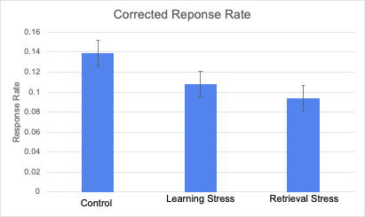
Did stress affect response rate?
Single factor ANOVA: p=0.037
2-tailed t-test assuming equal variance: p=0.0093
Notes:
Overall response rates of each group in the study. Appears it may be lower in the stress groups, but not statistically significant with the current sample.

Slide 10
Lag Measure
In control group, observed response one shape after transition more frequently than other responses
Quantified lag as no more than one shape, because average length spent in a community is small (6-7 shapes)
Parse on Step 2 would be considered a node response
Parse on Step 3 would be considered a lag response
1
2
3

Slide 11
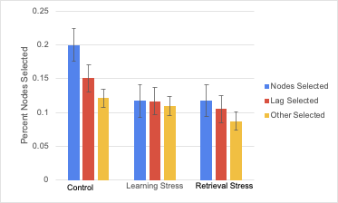
How does stress impact performance?

Slide 12
Next Steps
Continue Data Analysis
Effects on performance (with and without lag included)
Collect 20 individuals in each category that meet minimum response rate

Slide 13
References
1. Schapiro, A. C., Rogers, T. T., Cordova, N. I., Turk-Browne, N. B., & Botvinick, M. M. (2013). Neural representations of events arise from temporal community structure. Nature neuroscience, 16(4), 486.
2. Schapiro, A. C., Turk-Browne, N. B., Botvinick, M. M., & Norman, K. A. (2017). Complementary learning systems within the hippocampus: a neural network modeling approach to reconciling episodic memory with statistical learning. Philosophical Transactions of the Royal Society B: Biological Sciences, 372(1711), 20160049.
3. Schapiro, A. C., Gregory, E., Landau, B., McCloskey, M., & Turk-Browne, N. B. (2014). The necessity of the medial temporal lobe for statistical learning. Journal of cognitive neuroscience, 26(8), 1736-1747.
4. Gagnon, S. A., Waskom, M. L., Brown, T. I., & Wagner, A. D. (2018). Stress impairs episodic retrieval by disrupting hippocampal and cortical mechanisms of remembering. Cerebral cortex (New York, NY: 1991).

